Slide 1
Catholic Reformation
By Brian Cullinan

Slide 2
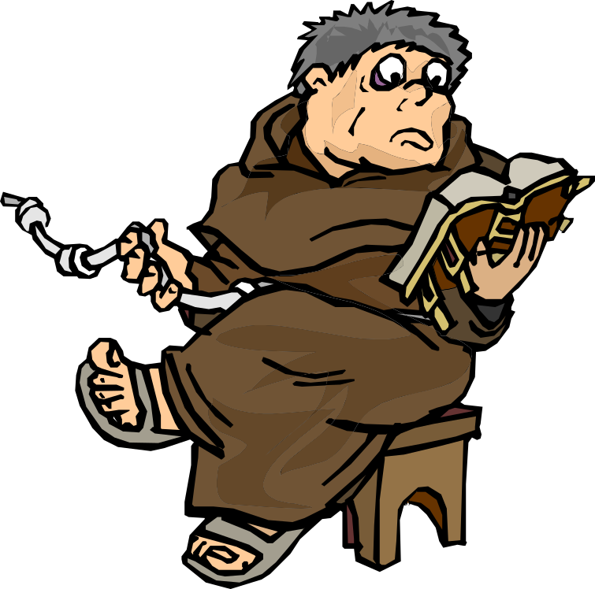
Background
At the beginning of the sixteenth century, The Catholic Church had become extremely powerful, but internally corrupt. Between 1215 and 1545 nine church-councils were held with church reforms as their primary intent. The councils all failed to reach significant unity. The clergy was unable to live according to church doctrine, and the abuse of church ceremonies and practices continued.
In the first half of the sixteenth century, Western Europe experienced a wide range of social, artistic, and geo-political changes as the result of a conflict within the Catholic Church. This conflict is called the Protestant Reformation, and the Catholic response to it is called the Counter-Reformation. The Reformation movement began in 1517 when a German Augustinian friar named Martin Luther posted a list of complaints, called the Ninety-Five Theses, against the Roman Catholic Church. As the spirit of reform spread, other leaders appeared: Ulrich Zwingli in Switzerland, French-born John Calvin who settled in Geneva, and John Knox who carried Calvin's teachings to Scotland.
In the Roman church a series of powerful popes including Leo X and Paul III responded to the reform demands in different ways. Mendicant orders such as the Jesuits formed to reinforce Catholic doctrine, and the Church continued to be supported by the major European monarchies. Reformation created a north-south split in Europe. The northern countries became Protestant while the south remains Catholic.

Slide 3
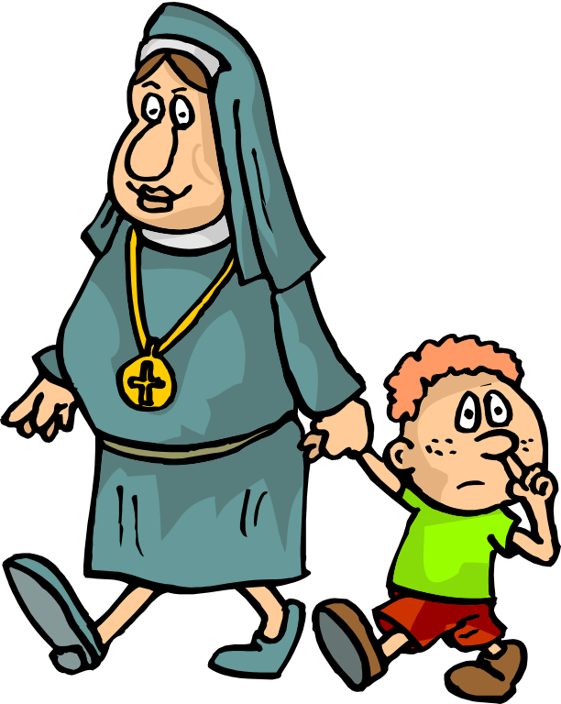
The Reformation and Art
Protestant reformers rejected the use of visual arts in the church. A wave of iconoclasm swept through the north. Stained glass windows were broken, images of the saints were destroyed, and pipe organs were removed from churches. The Catholic churches responded to this iconoclasm with an enthusiastic style of art and architecture called the baroque. The baroque is in opposition to Protestant severity. The theatrical designs of Saint Peter’s and the Gesù in Rome are a triumphant symbol of the Roman Catholic Church’s belief in itself and its history. The plain churches of the north are reminders of Protestant beliefs.

Slide 4
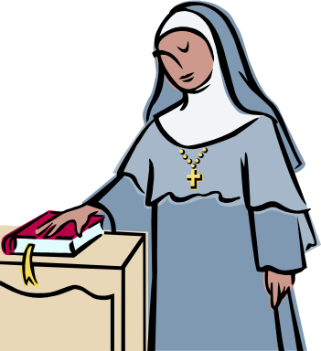
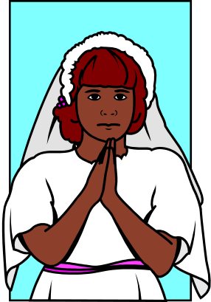
Martin Luther
Martin Luther (1483-1546) studied law at the University of Erfurt in Germany. He joined a monastic order, the Augustinians, and was eventually assigned as a lecturer at the University of Wittenberg. While working as a parish priest, Luther became disgusted by the Catholic Church's practice of selling indulgences. An indulgence assures the buyer a decrease of sins and so a shorter period in purgatory. Selling indulgences is a papal privilege which has been worked to the breaking point.
In 1517 an anniversary indulgence was being preached near Wittenberg to generate funds for the building of Saint Peter's in Rome. Luther used this opportunity to draw up a list of church activities for which he demands resolution and change. This list, the Ninety-Five Theses is centered on a call to eliminate the sale of indulgences. The Church demanded that he retract a number of his protests. Martin Luther refused.
Luther was summoned to an imperial Diet in Augsburg in 1518. Punishment for his crime should have been sentenced quickly, but the election of a new emperor, Charles V (1500-1558), slowed the justice system. Luther used his time to plan a complete reform program for the church. His reforms include:
National, rather than Roman, control of church finances,
Permission for the clergy to marry,
A series of sacramental reforms which reduce the sacraments to Baptism, a reformed Mass, and the Holy Eucharist.
Due to the invention of the printing press, Luther's reforms were quickly spread through Europe bringing much support. However, Luther was condemned as a heretic by Pope Leo X in the Edict of Worms. He was forced to escape and live for a year in hiding, but his reforms stood strong against the Catholic Church.

Slide 5


